Slide 1
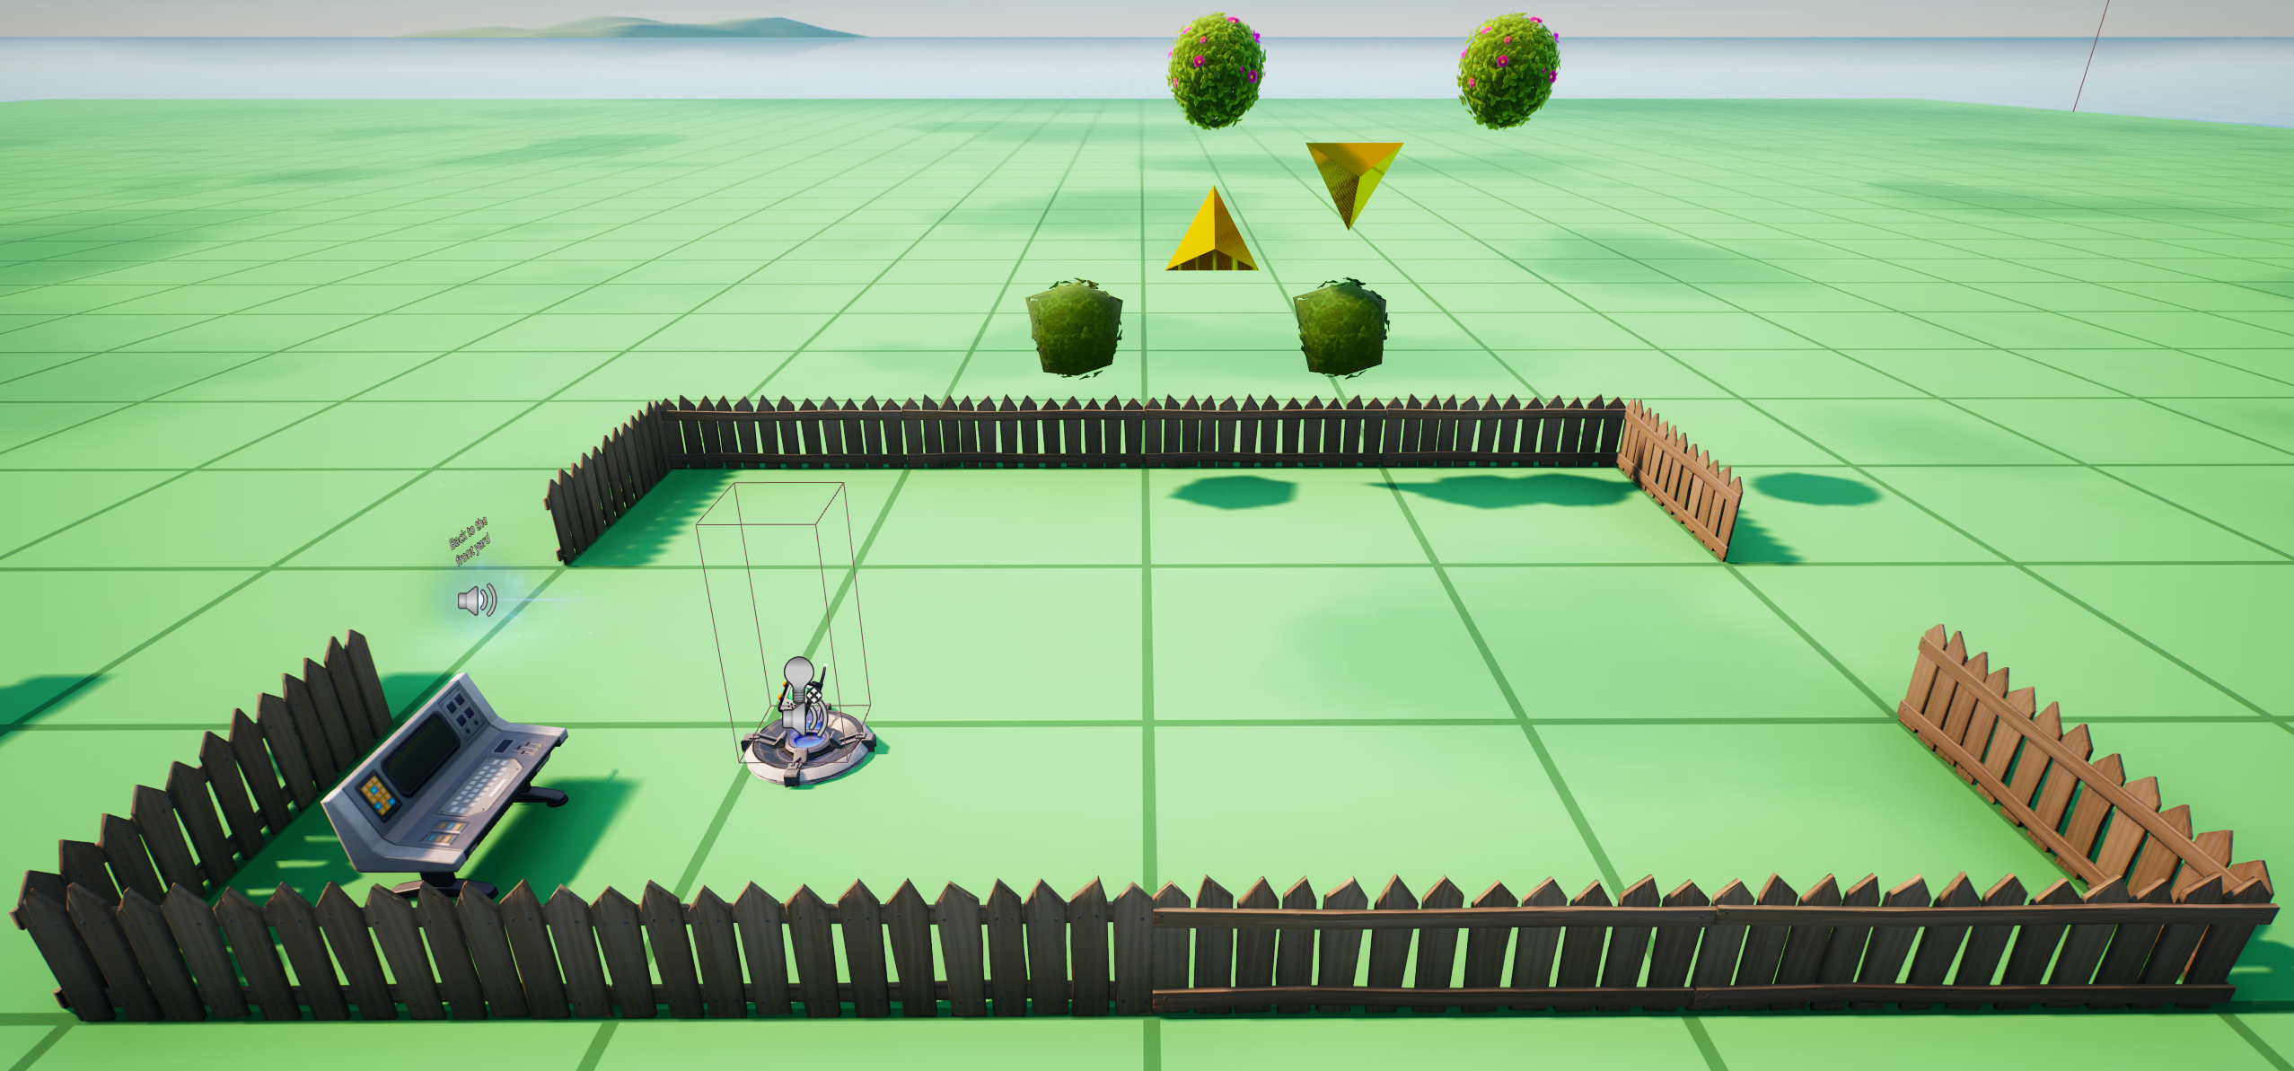
BallProps[2]
BallProps[3]
Marker0
Marker1
BallProps[0]
BallProps[1]
ConditionalButtonExchange2
MarkerProp
ConditionalButtonBlue

